Slide 2


Slide 3


Slide 4


Slide 5
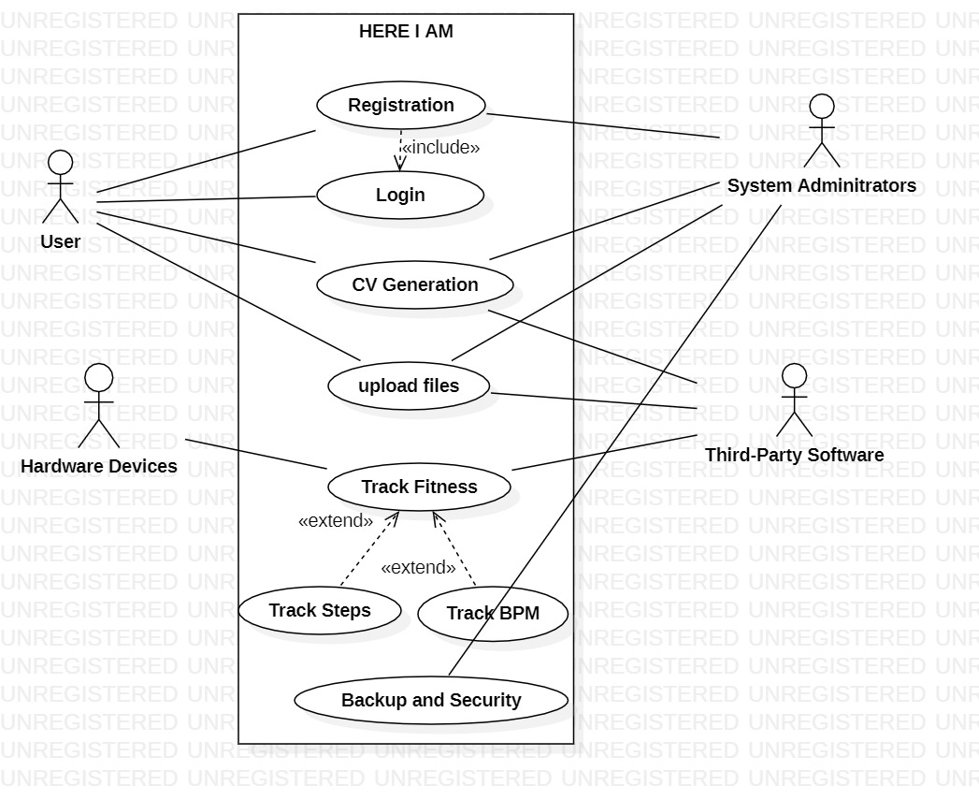

Slide 6
1

Slide 7
2

Slide 8
1

Slide 9
2

Slide 10
1

Slide 11
2

Slide 12
1

Slide 13
2

Slide 14
1

Slide 15
2

Slide 16
1

Slide 17
2

Slide 18
1

Slide 19
2

Slide 20
1

